Slide 1


BANNARI AMMAN
INSTITUTE OF TECHNOLOGY
(An Autonomous Institution, Affiliated to Anna University, Approved by AICTE, Accredited by NAAC with ‘A+’ Grade)
IoT HACKATHON
Team Name: Tech Titans
Problem Statement: Health Monitoring and Enhancing Virtual Medical Consultations
Team Details: (Anandan P, Heama Chandran V, Siva P)

Slide 2
Problem statement:
Current IV therapy methods have limitations in monitoring patient safety and treatment effectiveness. Manual monitoring is prone to errors and doesn't sync with electronic health records (EHRs).
Managing multiple IV lines is challenging, and ensuring IV fluid safety is complex. An IoT-based IV bag monitoring system is urgently needed to monitor patients in real time, sync with EHRs, manage multiple IV lines effectively, and guarantee IV fluid safety for better patient outcomes.

Slide 3
Abstract:
During pandemics like COVID-19, IV bag monitoring is crucial for delivering fluids and medications to patients efficiently. IV bags contain various solutions, including saline for hydration and medications like antibiotics.
IoT-based monitoring systems, using load sensors and ESP32 microcontrollers integrated with Blynk software, enable real-time tracking of IV fluid levels.
This technology helps hospitals manage resources effectively, prevent shortages, and address issues such as low fluid levels promptly. With remote monitoring capabilities, healthcare staff can oversee IV bag status from a distance, reducing exposure to infectious agents while ensuring continuous patient care

Slide 4
Proposed Solution:
In modern healthcare, IoT monitoring systems with load sensors and ESP32 microcontrollers integrated with Blynk software offer real-time tracking of IV fluid levels. This technology helps hospitals manage resources effectively, prevent shortages, and promptly address issues such as low fluid levels.
Remote monitoring allows healthcare staff to oversee IV bags from afar, reducing exposure to infectious agents while ensuring continuous patient care.
Integrating temperature sensors and pulse oximeters enables monitoring of IV fluid temperature and patient health parameters like oxygen levels and heart rate, enhancing overall patient safety and care quality.

Slide 5
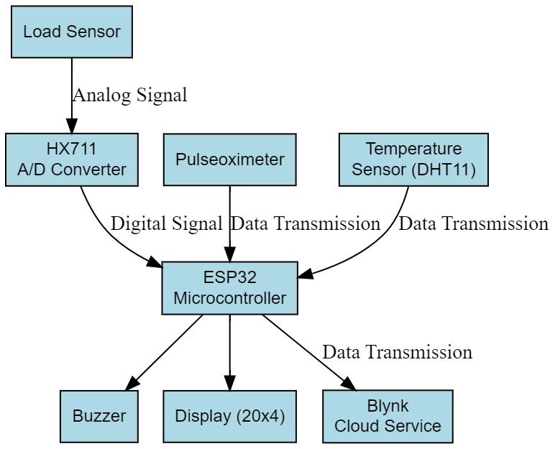
Approach:
Weight-based Monitoring: Utilize load cells or weight sensors underneath the IV bag to measure the weight of the fluid. As the fluid level decreases, the weight decreases accordingly. This method offers precise monitoring and can detect small changes in fluid levels.

Slide 6
Components required during the course of Hackathon:
ESP32
LOAD SENSOR
PULSE OXIMETER SENSOR
TEMPERATURE SENSOR
BUZZRE
HX711 AD CONVERTER
20*4 LCD DISPLAY

Slide 7

Elevator pitch video (1 minute)
Share the public link

